Slide 1
Front End Engineering-I| Project
Project : Gym Management System
Team Details:
MEMBERS:
Abhay pratap singh(2410990972)
Chetanya bhardwaj(2410991020)
DILJOT SINGH(2410991039)
Faculty: Mr.Shadab Ansari
:
Chitkara University Institute of Engineering and Technology,
Chitkara University, Punjab

Slide 2

Table of Contents
Introduction
Objectives
Problem Statement
Technical Details
Key Features
Project Highlights
Bonus Feature(optional)
Conclusion
References/Links used

Slide 3

Introduction
GymBuddy is a complete Gym Management System designed to automate and simplify all gym operations. It manages member registrations, trainer schedules, attendance tracking, and payment records. With a centralized database, it ensures smooth data flow between members, trainers, and admins, providing a secure and user-friendly platform for better gym management.
Automates gym operations seamlessly
Centralized and secure database management
User-friendly interface for admins, trainers, and members

Slide 4

Objectives
The objective of GymBuddy is to replace traditional manual systems with a modern, automated solution that increases efficiency and accuracy. The system aims to reduce paperwork, simplify processes, and improve communication between gym members, trainers, and management.
Automate registration, attendance, and payment processes
Provide personalized plans for members
Generate quick reports for better decision-making

Slide 5

Problem Statement
Traditional gym management involves maintaining paper records, which is time-consuming, error-prone, and difficult to track. Manual systems make it challenging to monitor payments, memberships, and attendance accurately. Trainers also struggle to manage workout plans efficiently.
Time-consuming manual processes
Data duplication and calculation errors
Difficulty in tracking payments and attendance

Slide 6
Proposed System
GymBuddy provides a centralized, automated platform that integrates all gym operations. Members can register online, select membership plans, make payments, and access personalized schedules. Trainers can assign workout plans and track member progress, while admins oversee operations through a single dashboard.
Online member registration and payment management
Automated trainer scheduling and attendance tracking
Real-time reports for admins and trainers

Slide 7


Technical Details
HTML (HyperText Markup Language)
Semantic Elements: Usage of elements like <header>, <nav>, <main>, <section>,
<article>, and <footer> to structure content.
Forms: Creation of forms for user input (e.g., sign-up, checkout) using <form>,
<input>, <select>, and <button>.
Images and Media: Usage of <img> for product images and <video> or <audio> for promotional content^{[2]}.
CSS (Cascading Style Sheets)
Responsive Design: Utilization of media queries to ensure the website looks good on
various devices.
Flexbox/Grid Layout: Implementation of Flexbox or CSS Grid for flexible and responsive layouts.
Animations and Transitions: Usage of CSS transitions and animations for interactive elements (e.g., hover,action)

Slide 8

7.Alt Text: Include alt attributes for images to improve accessibility and search engine ranking.
Testing and Debugging
Cross-Browser Testing: Testing website on different browsers and devices to ensure compatibility.^{[5]}
Validation: Usage of tools to validate HTML and CSS for standards compliance.

Slide 9

Key Features
1. Member Management 👤
Online member registration & profile management
Membership plan selection & renewal reminders
Progress tracking, workout & diet schedules
View attendance & payment history
2. Trainer Management 🧑‍🏫
Assign personalized workout & diet plans
Manage member schedules & progress
Track member attendance & performance

Slide 10
3. Attendance Management
Automatic check-in & check-out system
Real-time attendance reports
Alerts for inactive members
4. Payment & Billing
Online & offline payment handling
Automated invoices & receipts
Payment reminders & pending payment tracking
5. Admin Dashboard
Manage members, trainers, and plans
Access reports & analytics
Configure fees and membership plans

Slide 11
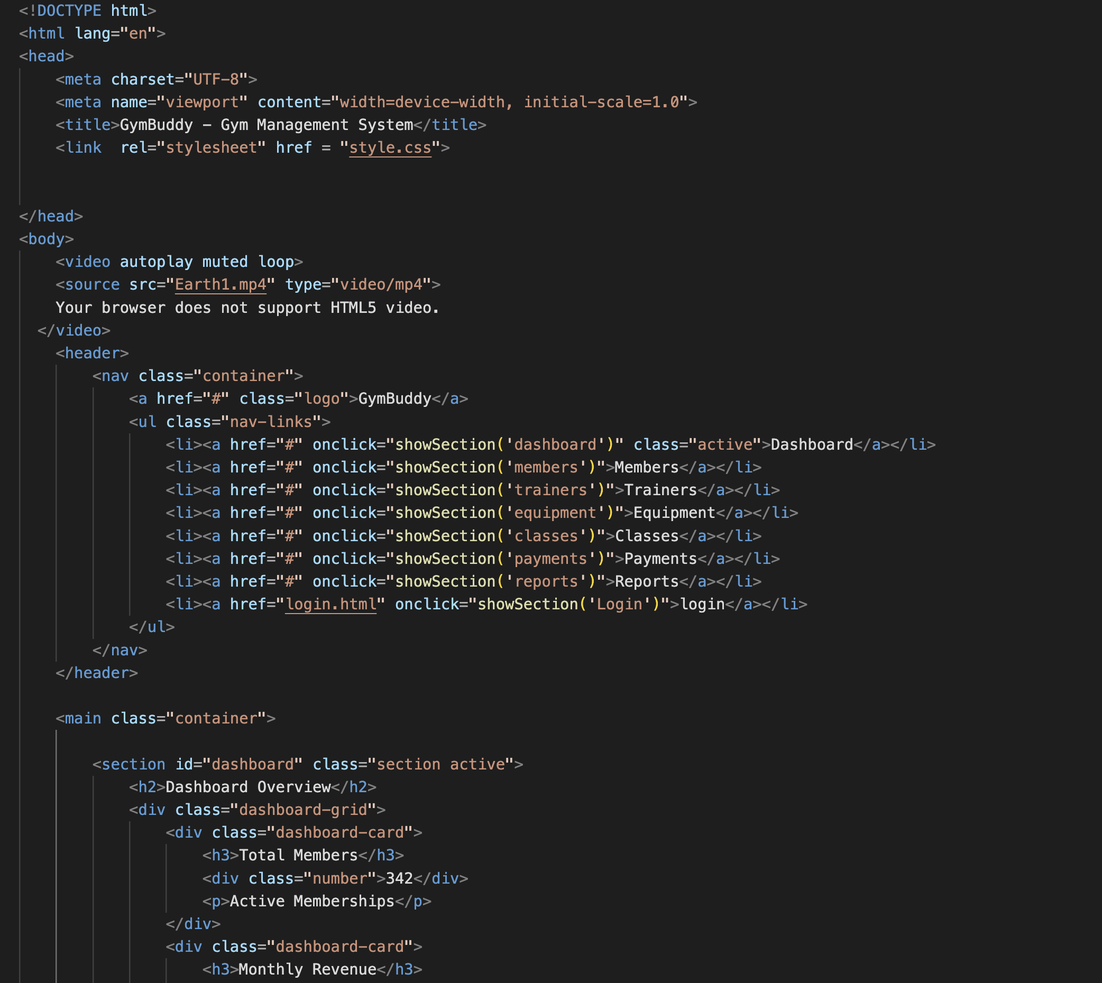
Project Highlights: HTML

Slide 12
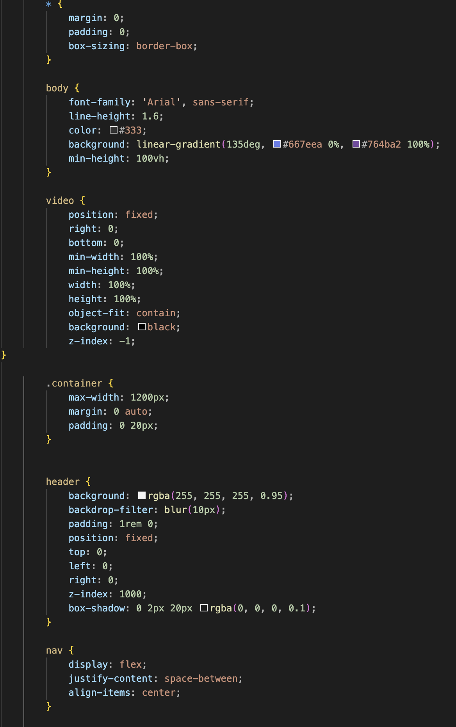
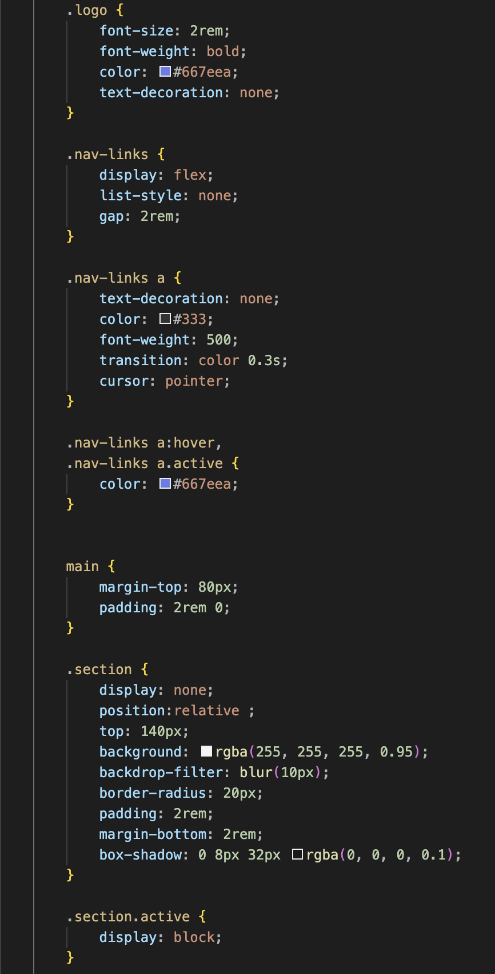
Project Highlights: CSS

Slide 13
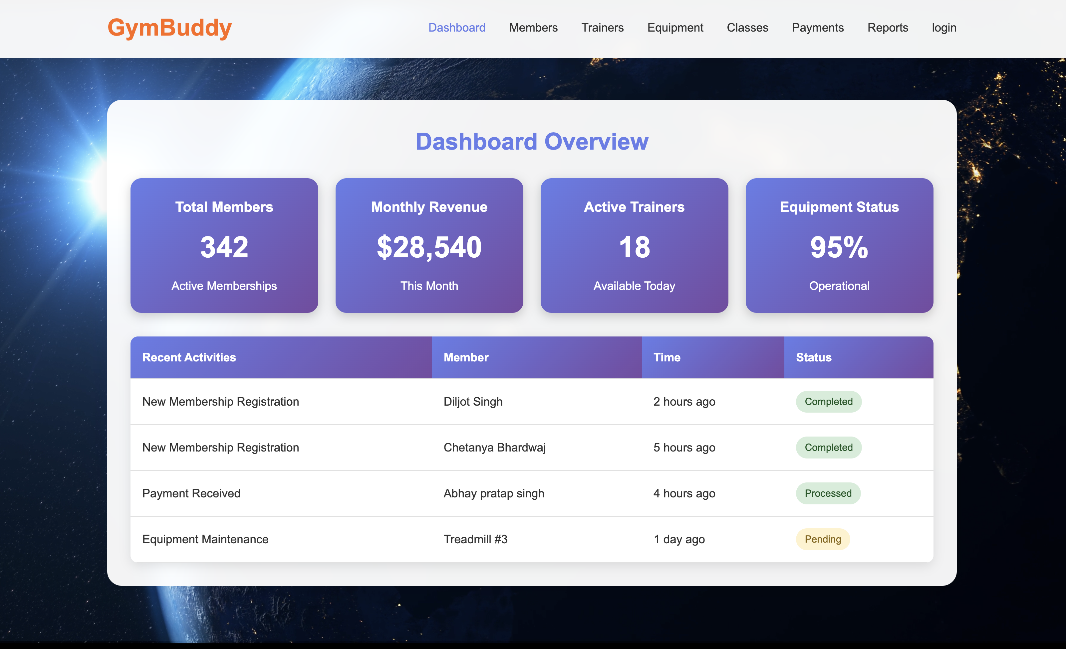
RESULT

Slide 14
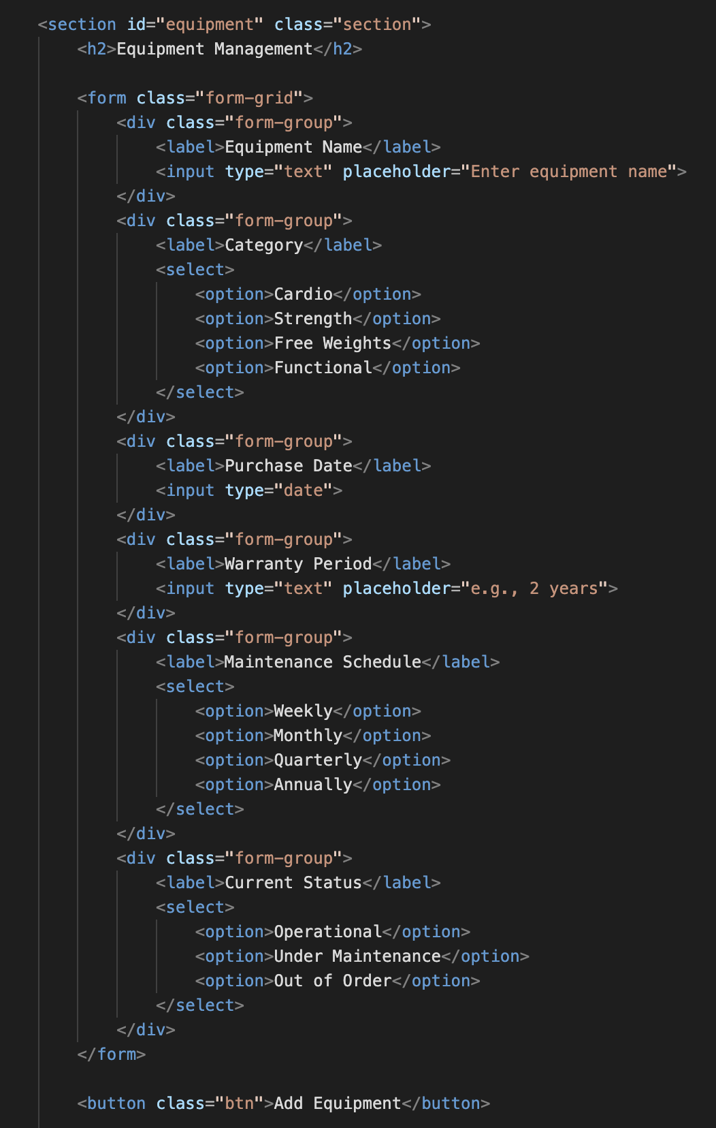
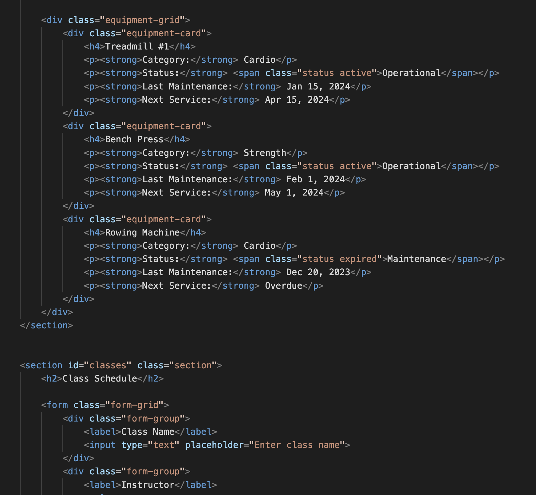
HTML:Equipment

Slide 15
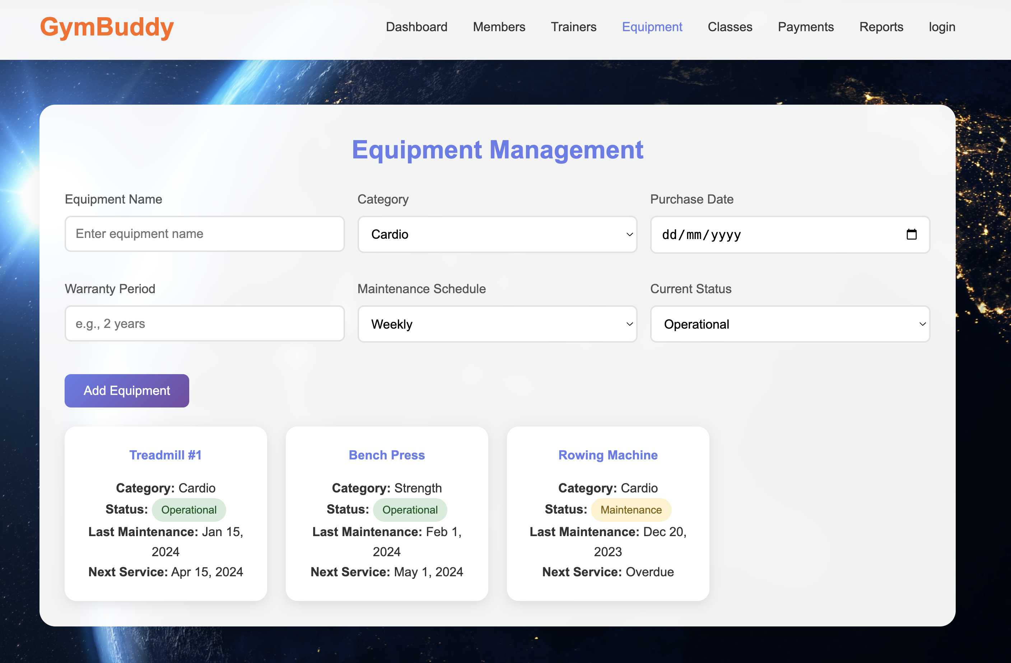
RESULT

Slide 16
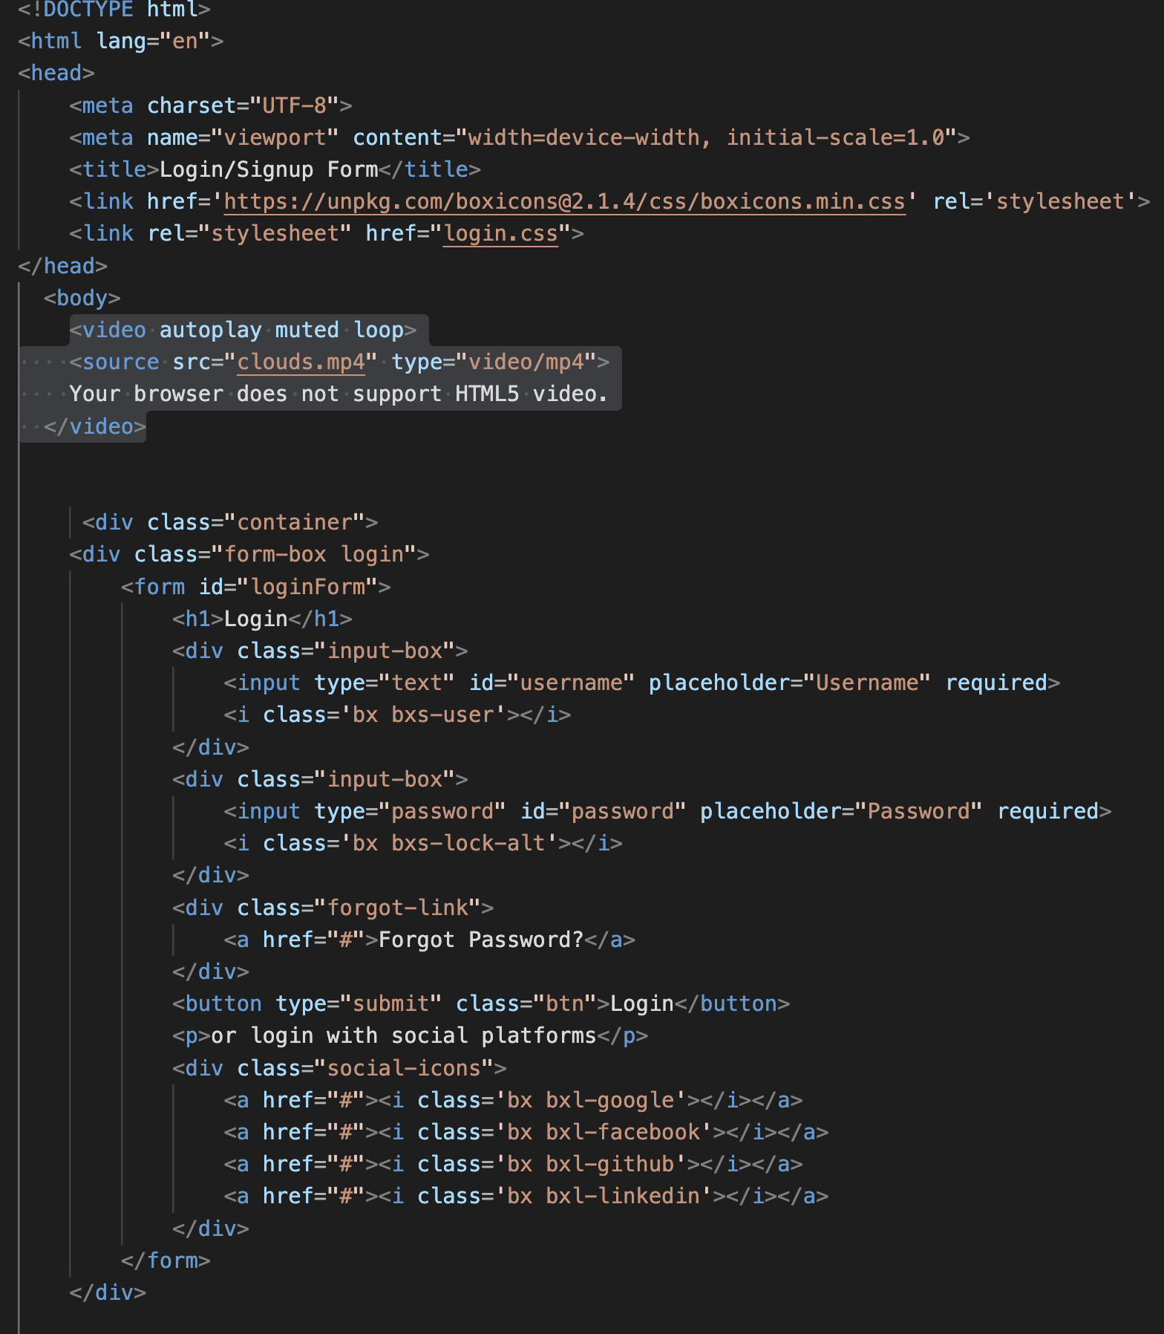
Login Page

Slide 17
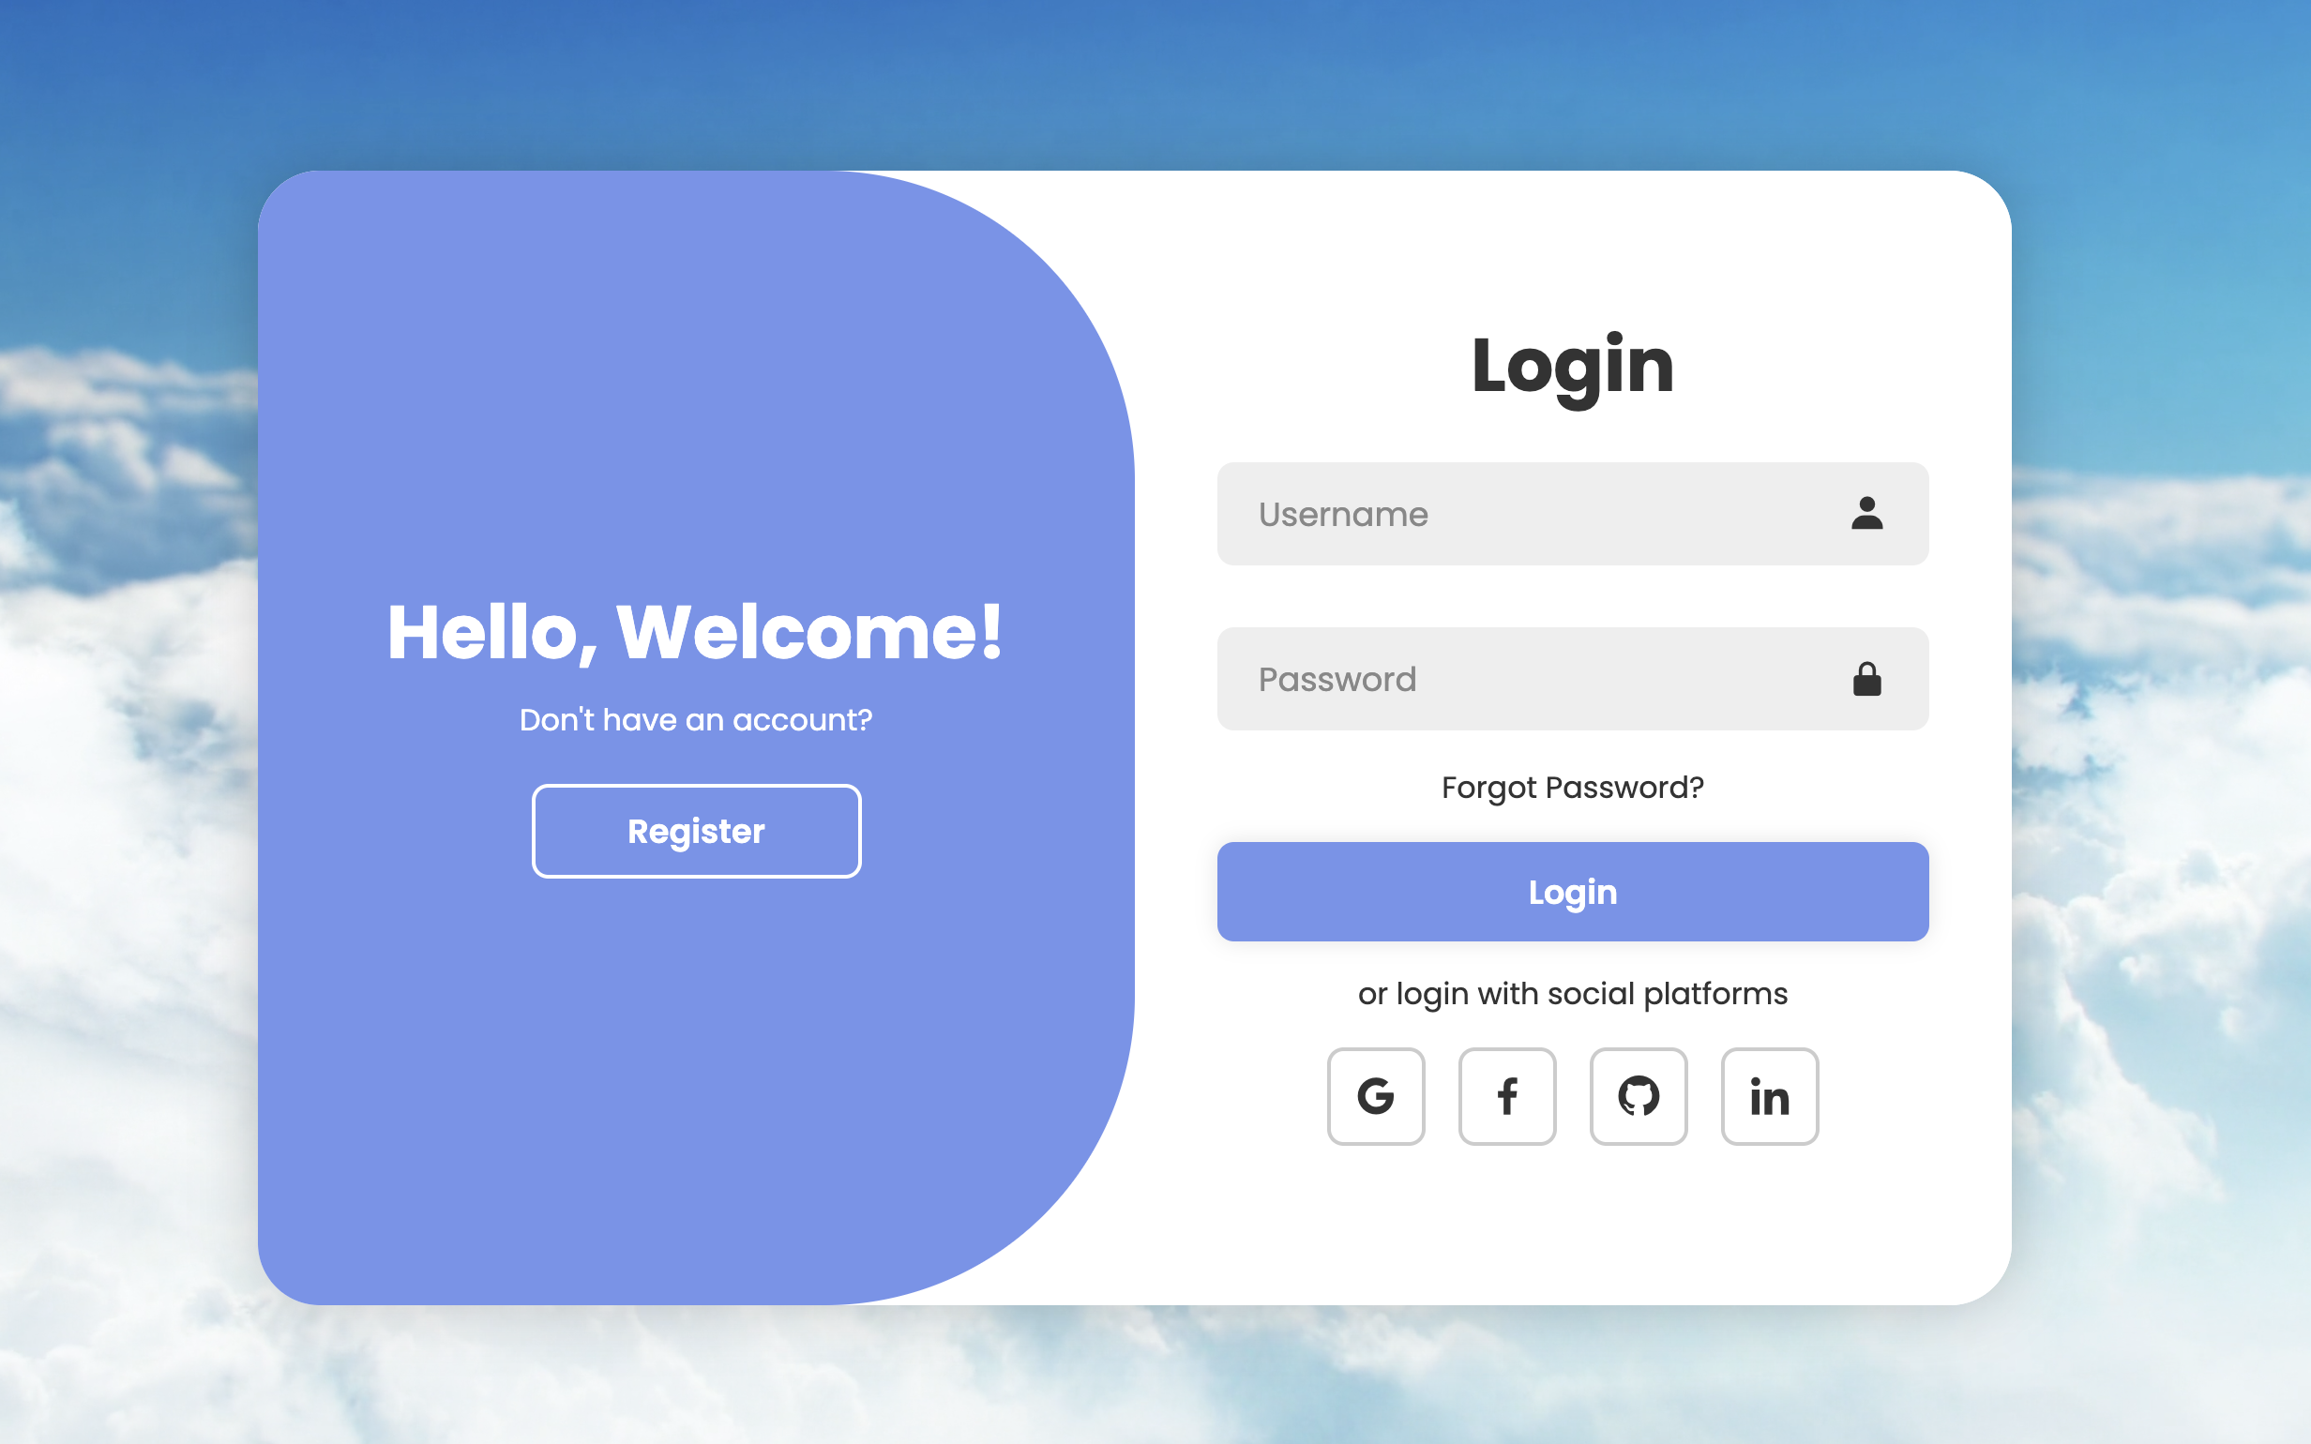
RESULT

Slide 18

Conclusion
GymBuddy is a smart and efficient Gym Management System that automates daily operations like member registration, payments, attendance, and workout planning. It improves accuracy, saves time, and provides a better experience for members, trainers, and admins. With its user-friendly interface and secure management, Gym Buddy makes gym operations simpler, faster, and more effective.

Slide 19
References/Links used
"Amazon Empire: The Rise and Reign of Jeff Bezos". PBS. Archived from the original on January 16, 2020. Retrieved February 15, 2020^{[1]} .
Wienclaw, Ruth A. (2013). "B2B Business Models" . Research Starters: Business. Archived from the original on 18 July 2013. Retrieved 4 May 2021.
Khurana, Ajeet (25 November 2019). "Did You Know That There Are 4 Types of Ecommerce?". The Balance Small Business. Dotdash. Archived from the original on 22 January 2021. Retrieved 4 May 2021.
"Pixabay home page". Pixabay.com. Archived from the original on 2019-01-30. Retrieved 2018-10-01.
Link-https://pixabay.com/
"Font Awesome v1.0.0". Github. 2 February 2022.
Link-https://fontawesome.com/

Slide 20


THANK YOU

